Slide 1


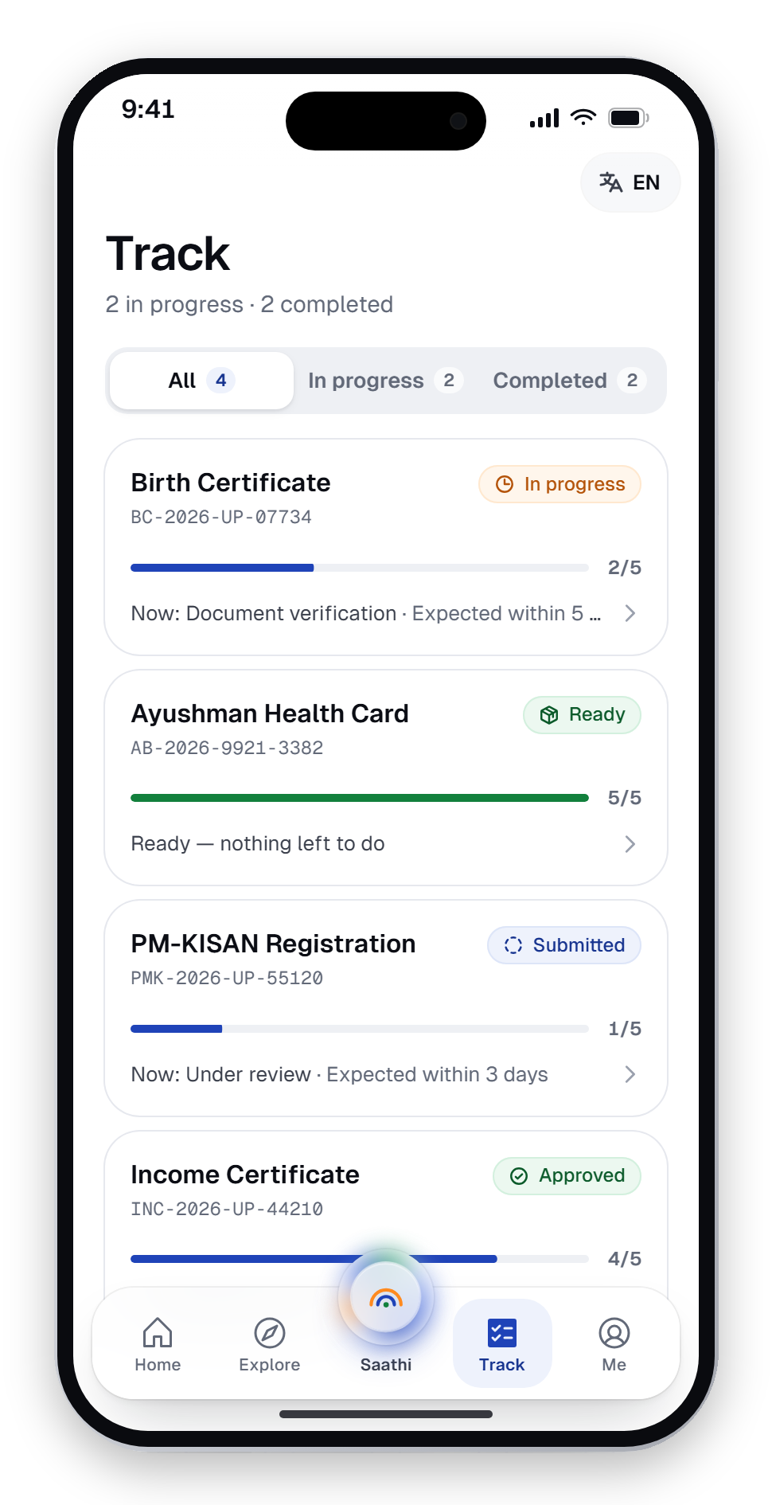
साथी
SAATHI
Minor Project · Phase 3
Planning, Budgeting, Task Definition & Preliminary Design
Smart City Citizen
Services App
Saathi — one door to every government service. A multilingual, voice-first citizen app with an assistant that asks before it acts.
SUBMITTED BY
DEPARTMENT
Krishom Sharma
UIC
BCA (UI/UX Designs)
University Institute of Computing
UID — 24BCU10002
A design concept. Not affiliated with the Government of India.

Slide 2
What this phase covers
Phase 3 plans the work, prices it, breaks it into tasks and shows the first design.
01
Methodology
07
Risks & mitigation
Double Diamond, applied to a civic product
What could go wrong, and the plan
02
Project timeline
08
Information architecture
A 16-week plan with phase milestones
Five tabs with the assistant at the centre
03
Work breakdown
09
Key flow — Saathi AI
Five workstreams, every task named
Ask → plan → approve → done
04
Task definition
10
Design system
Deliverable, duration and tools per task
Bharat Precision: colour, type, imagery, motion
05
Tools & resources
11
Preliminary screens
An open-source stack and test devices
Citizen app and department console
06
Budget
Indicative costs — software at ₹0

Slide 3




Methodology — the Double Diamond
Diverge to understand, converge to define; diverge to explore, converge to deliver.
Problem space
Solution space
01 Discover
02 Define
03 Develop
04 Deliver
Field conversations · app audit · standards review
Personas · problem statement · objectives · scope
IA · flows · design system · prototype · agent
Testing · language review · build · case study

Slide 4
Project timeline
Planned schedule across a 16-week semester, with the three phase reviews and the expo as milestones.
W1
W2
W3
W4
W5
W6
W7
W8
W9
W10
W11
W12
W13
W14
W15
W16
Research & problem definition
Scope & literature review
Information architecture & flows
Design system (Bharat Precision)
Prototype screens & apply engine
Saathi AI — scripted agent
Department consoles
Website & case study
Testing & language review
Final build & submission
Define
Design
Build
Validate & ship
Phase 1 review
Phase 2 review
Phase 3 review
Project Expo

Slide 5
Work breakdown structure
Five workstreams; every leaf is a task with an owner, an output and a date.
Saathi — Smart City App
1.0 Research
2.0 Design
3.0 Prototype
4.0 Language
5.0 Validation
1.1
Citizen conversations
2.1
Information architecture
3.1
App shell & tabs
4.1
Locale infrastructure
5.1
Contrast tests
1.2
App & portal audit
2.2
User flows
3.2
42 apply flows
4.2
Hindi · Bengali · Tamil
5.2
Agent unit tests
1.3
Personas
2.3
Design system
3.3
Saathi AI agent
4.3
13 machine-assisted
5.3
Usability sessions
1.4
Problem statement
2.4
High-fidelity screens
3.4
Dept. consoles
4.4
Per-script typography
5.4
Case study & expo

Slide 6
Task definition
Each task, what it produces, how long it takes and what it is built with.
# | Task | Deliverable | Duration | Tools
T1 | User research & personas | 4 personas, frictions, quotes | 2 wks | Interviews, notes
T2 | Problem definition & scope | Problem statement, objectives, scope | 1 wk | Docs
T3 | Literature & benchmark review | Standards map, UMANG comparison | 2 wks | Web research
T4 | Information architecture | 5-tab IA, sitemap, user flows | 1 wk | Diagrams
T5 | Design system | Tokens, type, icons, imagery, motion | 2 wks | Tailwind, Phosphor
T6 | Prototype & apply engine | All screens + 42 apply flows | 4 wks | Next.js, React, TS
T7 | Saathi AI agent | 6 missions, consent gate, outcomes | 2 wks | TypeScript, Vitest
T8 | Department consoles | 15 consoles, audit trail | 2 wks | Next.js
T9 | Languages & accessibility | 17 locales, a11y modes, contrast tests | 2 wks | next-intl
T10 | Testing, website & submission | Case study, static build, expo deck | 2 wks | Hostinger

Slide 7












Tools & resources
An open-source stack, so the software budget stays at zero.
Next.js 14 + React 18
TypeScript
Tailwind CSS
Framer Motion
App framework, static export
Typed models for flows and agent
Design tokens as utility classes
Springs, transitions, reduced motion
next-intl
Phosphor Icons
Vitest
Git & GitHub
23 locales, live language switch
One icon family, three weights
Unit tests for agent and contrast
Version control, one commit per phase
Hostinger
Test devices
Google Fonts / OFL
Chrome DevTools
Static hosting for the live demo
Android + iPhone, slow-network mode
Geist, Instrument Serif, Anek, Noto
Lighthouse, accessibility checks

Slide 8
Budget — an indicative estimate
Student-project costs in ₹. Software, fonts and icons are open-source, so the spend goes on hosting and people.
Item | Cost (₹)
Web hosting (12 months) | 2,400
Usability testing — 8 participants | 2,000
Field research travel | 1,500
Mobile data & internet | 1,200
Domain name (1 year) | 800
Printing & report binding | 600
Software, fonts & icons | 0 · open source
Total (estimated) | ₹ 8,500
Indicative estimates for planning; actual prices vary by plan and provider.

Slide 9
Risks & mitigation
What could derail the project, and what is already in place.
RISK
IMPACT
MITIGATION
Translations read as machine-made
High
Hindi, Bengali, Tamil authored by hand; 13 more flagged for native review before any pilot
Assistant acts without consent
High
Scripted, reviewable missions; consent gate in code; red-team the agent before release
Mistaken for an official app
Medium
Own brand mark, no emblem, disclaimer on every page, all data labelled sample
Scope creep across 42 flows
Medium
One shared apply engine; flows are data, not separate screens
Inaccessible to low-vision users
Medium
Contrast tested in code against WCAG 2.1 AA; larger text, read-aloud, slow mode
Slow on weak networks
Low
Static export, no 3D libraries, fonts load only for the script in use

Slide 10





Information architecture
Five tabs. A bare “Apply” tab asks “apply for what?” — so the centre of Saathi is the assistant.
साथी Saathi
Home
Explore
Saathi AI
Track
Me
Saathi ID card
Life moments
Ask by voice or text
Applications
Document wallet
Needs attention
Services (42 flows)
Plan & sources
Status timeline
Family / proxy
My applications
Schemes
Consent gate
Named officers
Privacy dashboard
Schemes for you
Search, any language
Outcome + receipt
“Why the delay?”
Language & access

Slide 11






Key flow — Saathi AI asks before it acts
Rakesh asks for his daughter's birth certificate, in Hindi. Four steps, one consent, real proof.
01
Ask
02
Plan
03
Approve
04
Done
मेरी बेटी का जन्म प्रमाणपत्र बनवाना है
Fetch the hospital birth record from DigiLocker
Share with Nagar Nigam, Kanpur?
Application submitted
Fill Form 1 for e-District
Your name and address
SAA-2026-457029
Aanya's hospital birth record
Priya Nair is reviewing it
“I need to get my daughter's birth certificate”
Certificate expected in 7 days
Check Janani Suraksha Yojana eligibility
Valid until the application closes
You may also get ₹1,400 under Janani Suraksha Yojana.
By voice or text, in any of 17 languages
Submit to Nagar Nigam, Kanpur
Approve
Edit
Nothing leaves the phone without a yes
Every step names its official source

Slide 12




Design system — Bharat Precision
Calm enough to trust with a pension, precise enough to feel world-class.
COLOUR WITH A JOB
Kolam & guilloche
TYPE ACROSS SCRIPTS
Chakra Navy
Aa
Precision.
Imagery made in code — kolam line art and security linework. No stock photos, no maps.
#1F43B8 · Actions, links, focus
India Green
Phosphor, one family
#12803C · Verified, approved, done
साथी
நான் உதவலாம்
Regular for chrome, duotone for tiles, fill for the active tab.
Saffron
#FF8A1F · Highlights — never body text
Geist for Latin UI · Instrument Serif for one emotive word · Anek (Ek Type, an Indian foundry) for Indic headlines · Noto Sans for Indic body at 1.8 line-height (UX4G) · Tiro Devanagari for the wordmark.
Motion with a reason
Ink
UI motion under 300 ms, always interruptible; fades only for reduced motion.
#0B0D14 · Text
White
Contrast, tested
#FFFFFF · Every surface
Every text colour checked ≥ 4.5:1 against WCAG 2.1 AA in automated tests.

Slide 13
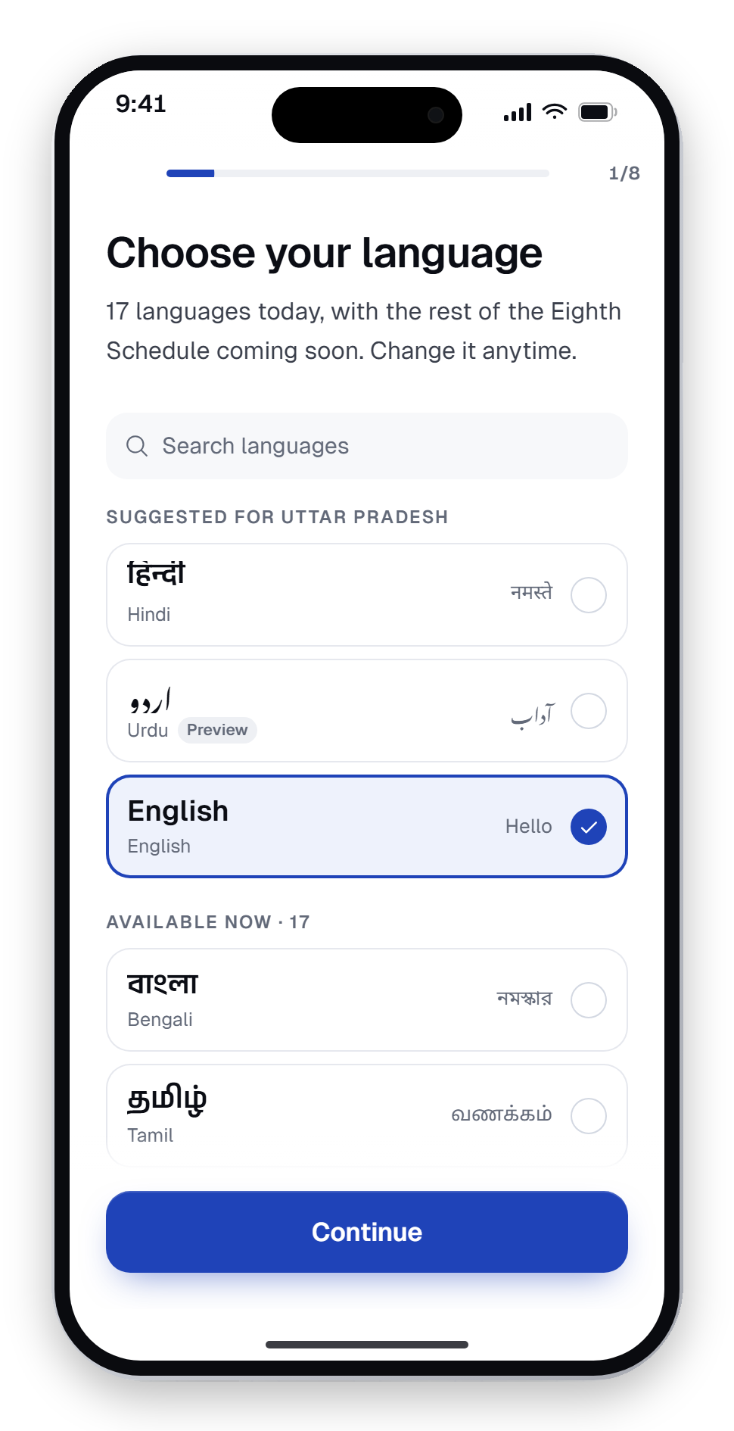
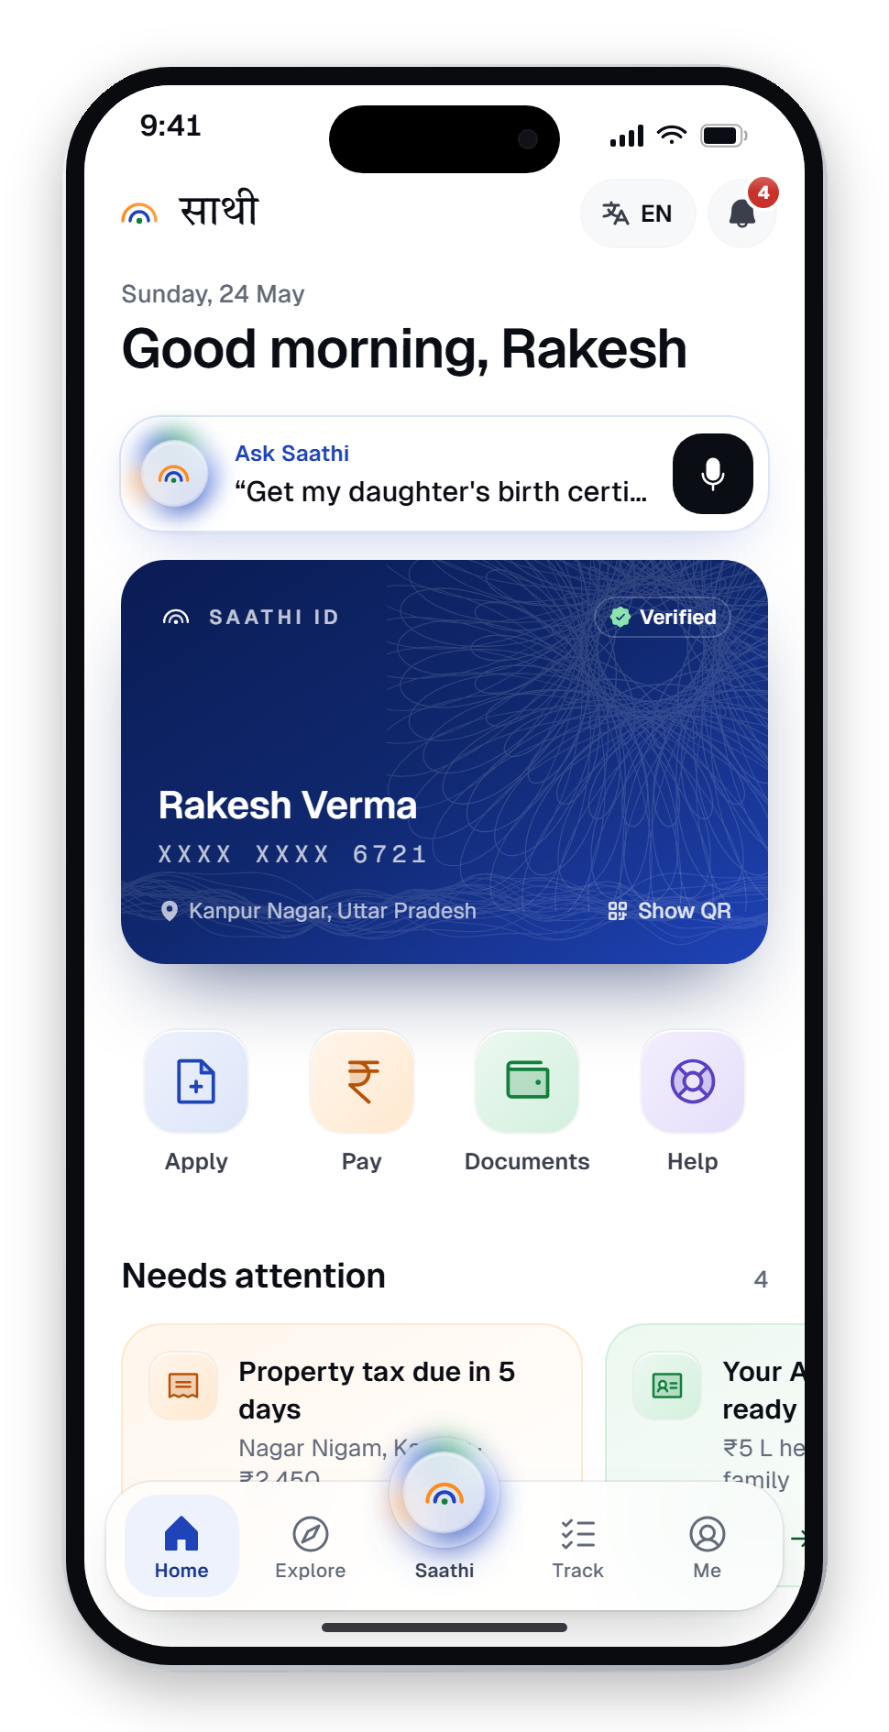
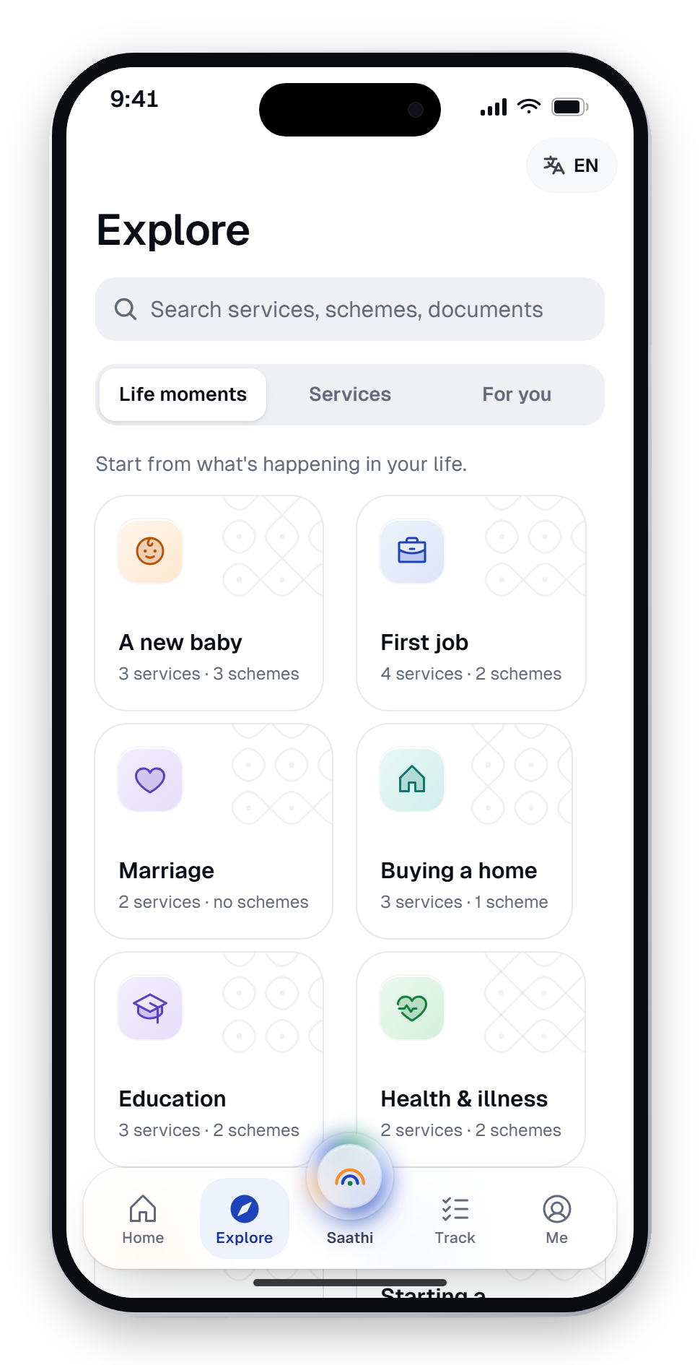
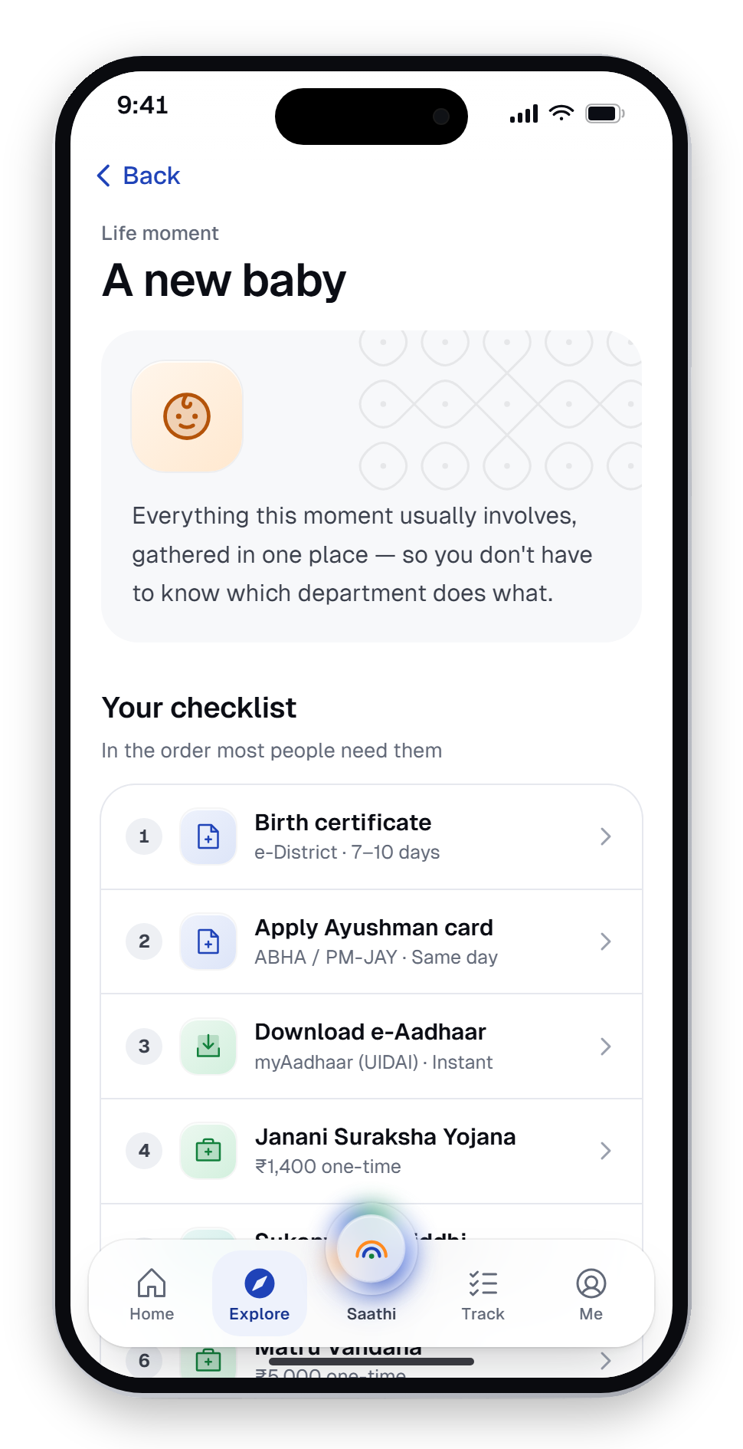
Preliminary screens — citizen app
Onboarding with consent, a home that knows what needs attention, and services found by life moment.
Onboarding
Home
Explore
A new baby
Language first — 17 today
Identity, nudges, applications
Life moments, services, schemes
One checklist, many departments

Slide 14
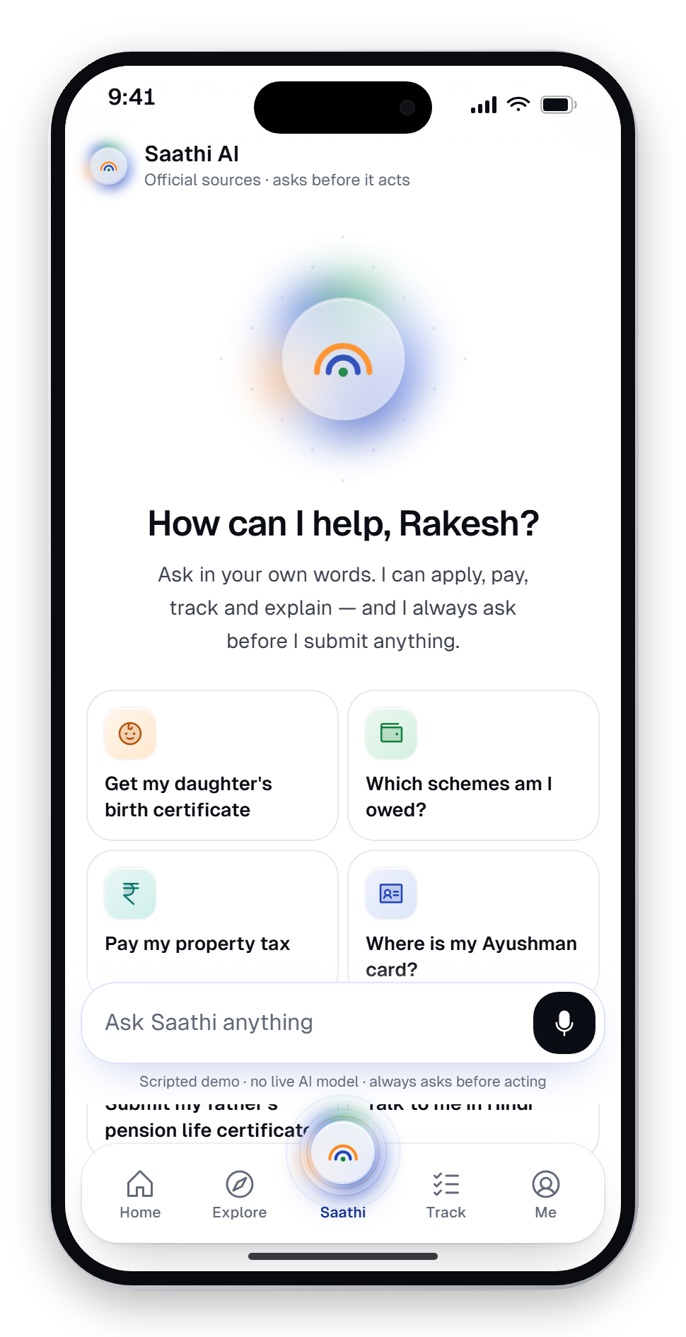
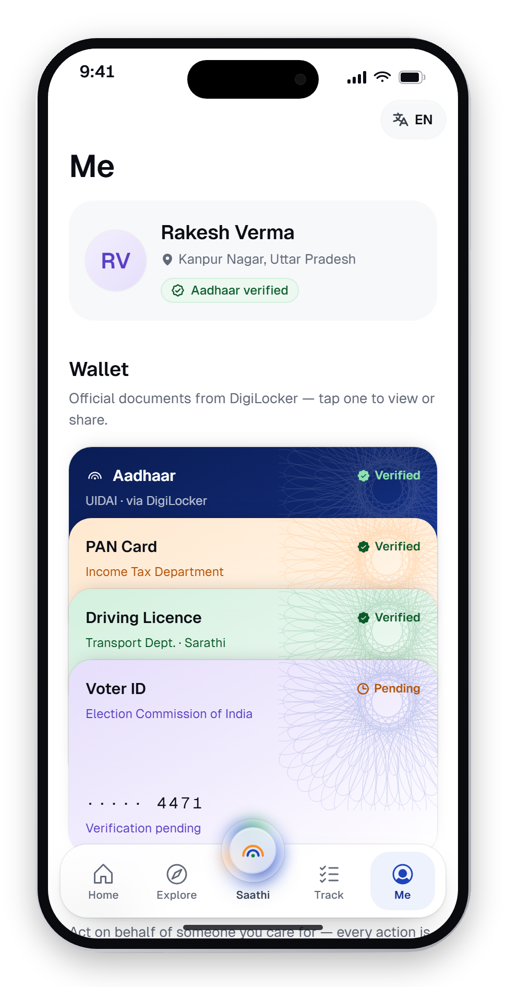
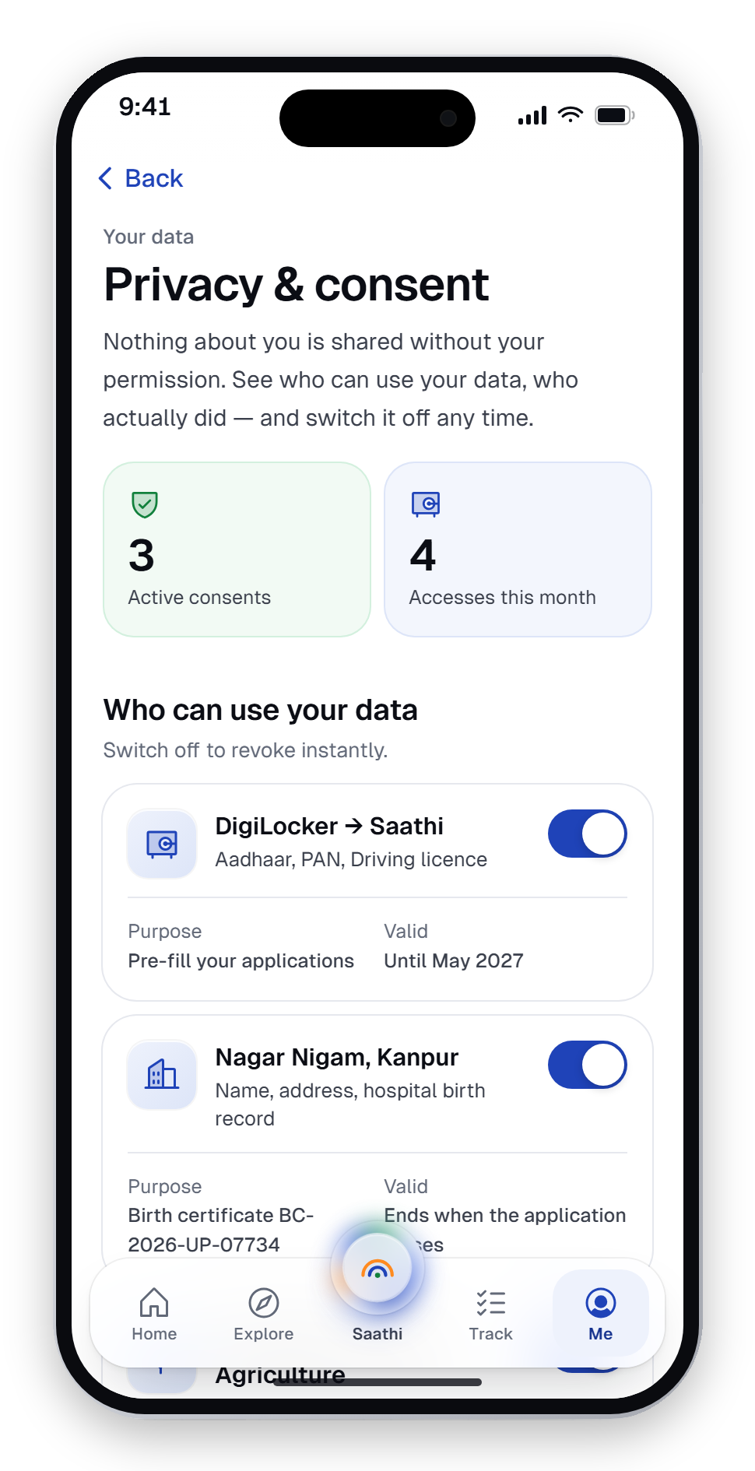
Preliminary screens — trust & status
The assistant, the timeline and the wallet — where trust is earned.
Saathi AI
Track
Me
Privacy & consent
Ask in any words
Stages, officers and dates
Tinted document wallet
Who used your data — revoke

Slide 15
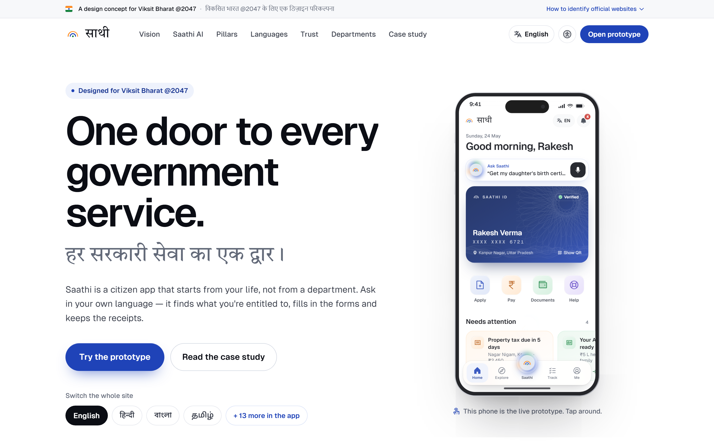
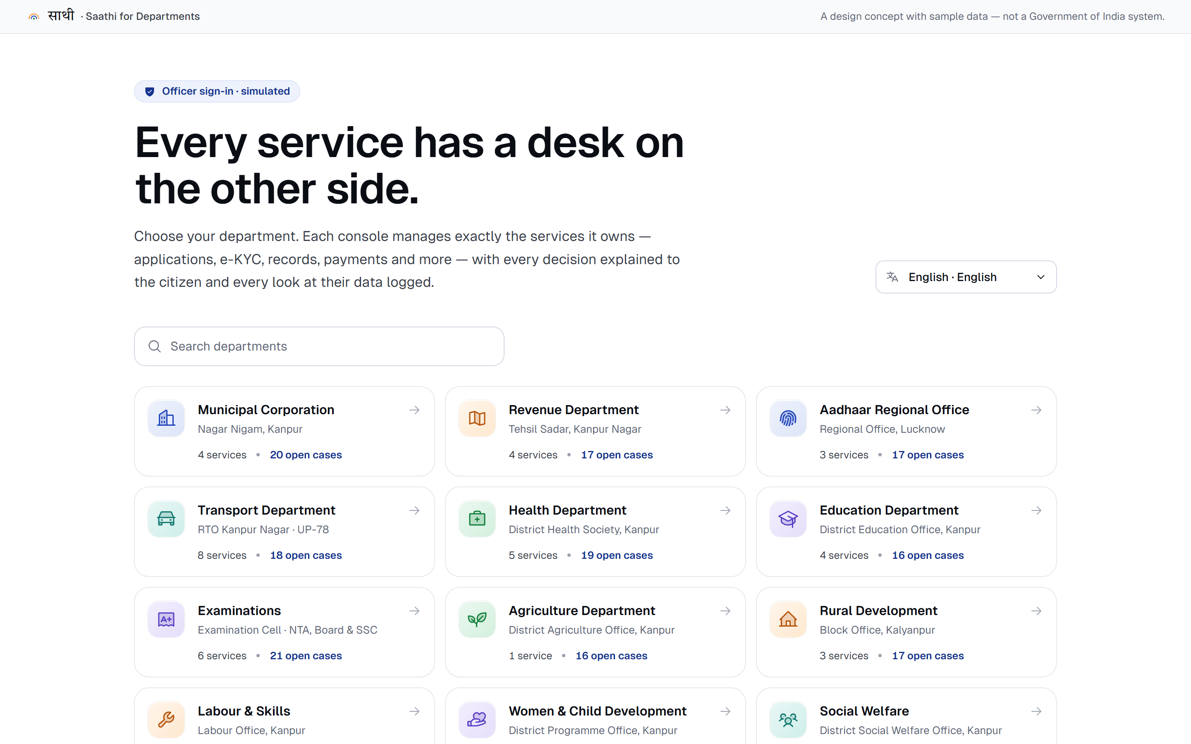
Both sides of the counter
The citizen's website and the officer's console — every decision reaches the citizen live, in their language.
Website — “One door to every government service”, with the live prototype embedded
Saathi for Departments — 15 consoles, masked e-KYC, audit trail

Slide 16

Thank you.
Phase 3 planned the work, priced it, broke it into tasks and produced the first complete design of Saathi.
NEXT · BUILD, TEST & PROJECT EXPO
Usability sessions in three states, native-language review, and the live prototype at the expo.
Krishom Sharma · BCA (UI/UX Designs) · UID 24BCU10002

